Slide 1
Santander Customer Satisfaction
Team : Uncertainty
Suraj Kumar Mondal, Saurabh Shetty, Vishal Kumar and Nazim Saifi

Slide 2




Story of Poo…The Businessman
I am Poo
Happy Poo
Who? Why?
Don’t fear. I am here.
Data Scientist
Confused Poo

Slide 3
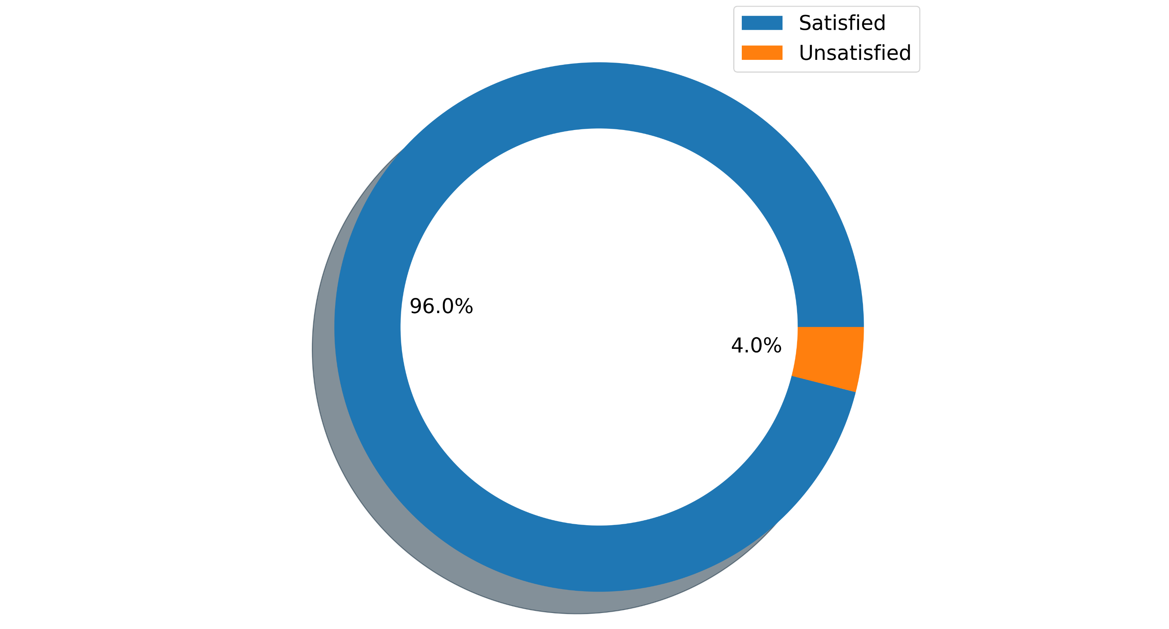


Details of the data set
Train data size : 56970 × 371
Test Data size : 14243 × 371
Total Predictors : 370
Response Variable : TARGET
Data is highly imbalanced and each Predictor is anonymous!!
Target service acceptance from train data

Slide 4

DATA CLEANING
1
So much to do.
2
EXPLORATORY DATA ANALYSIS
3
BASE MODEL GENERATION
ENSEMBLE MODELS
4
EXPERIMENTATION
5
6
INTERPRETATION
7
CONCLUSION

Slide 5
Exploratory Data Analysis
Train Data
(371 Columns)
Removing Duplicate Features (29)
Separate Categorical And Numerical Features
Numerical Features (250)
Dropped ID and TARGET
Dropped Correlated Features (62)
TARGET
Categorical Features (56)
Train Set
Removing Constant Value Features (34)
Split Data into train and test set using Stratification
Predictors
(369 Columns)
Test Set
Scaled Numerical Features

Slide 6
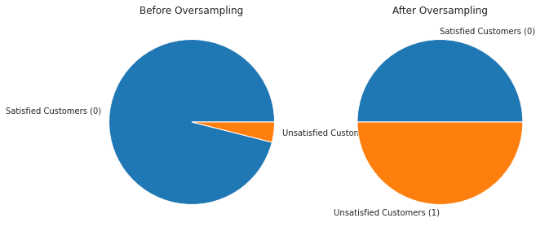
Exploratory Data Analysis
Numerical Features (188)
Categorical Features (56)
Joined Data
244 Predictors
Dropped Sparse columns (23)
Over-sampling
(109436, 221)
Processed Data

Slide 7
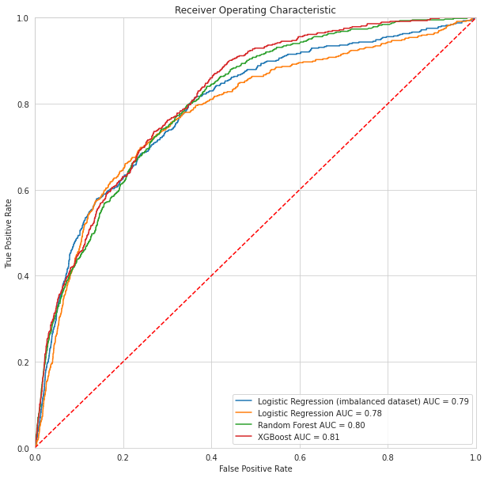
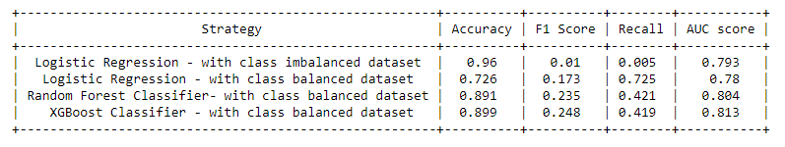
Model Generation
Base Model : Logistic Regression
Tree Based Ensemble Model :
Random Forest Classifier
XGBoost Classifier

Slide 8
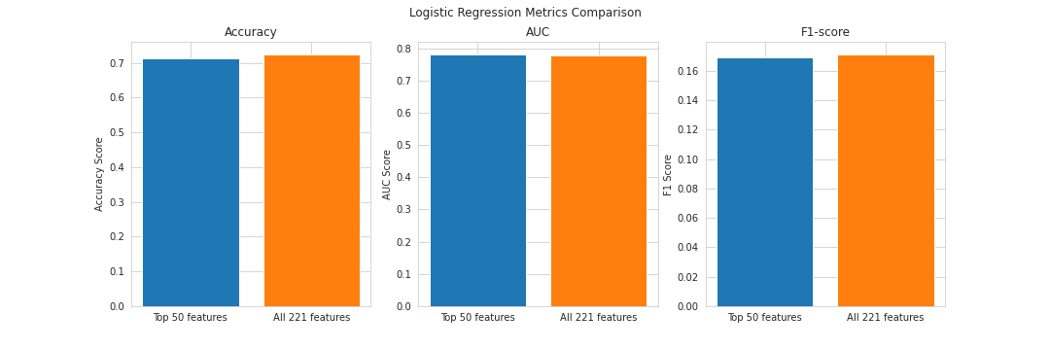
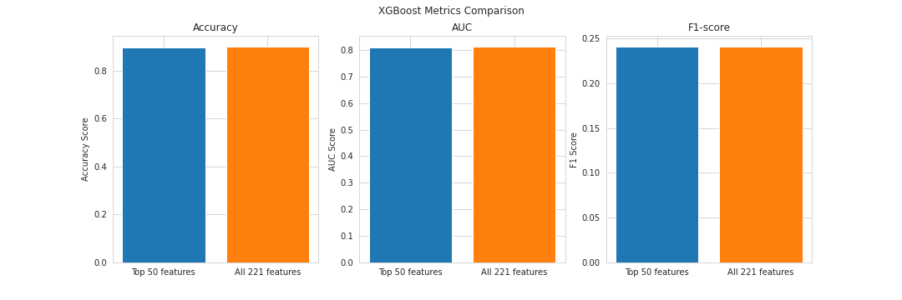
Feature Selection using Permutation Importance
Feature selection using permutation combination was done.
By using top 50 features, we got similar evaluation metrics.

Slide 9
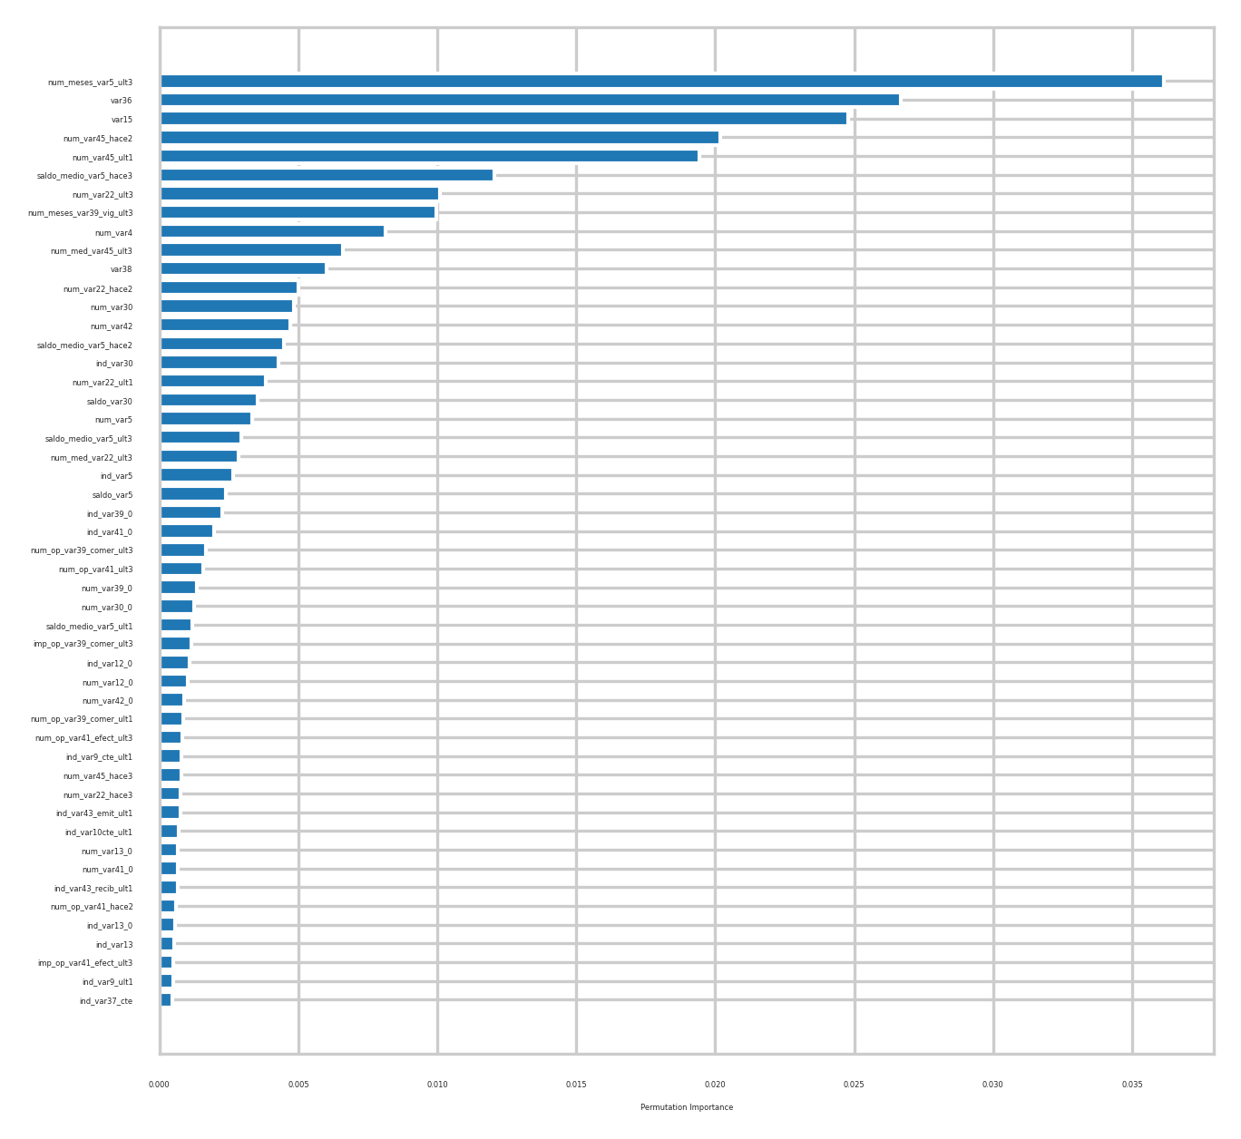

Slide 10
Conclusion
Accuracy score is not the best score to evaluate the performance of a model.
For imbalanced dataset ROC-AUC score and F1 score are better metrics to evaluate the model.
From these metrics, we find that XGBoost Classifier is the best model followed by Random Forest and Logistic Regression trained on the Santander Dataset.

Slide 11

Job done.
Thankyou
Team Uncertainty

